Slide 1

WEB DEVELOPMENT
Part 2

Slide 2
The Web Platform
•HTML5, according to Jason and
James (2014) is a web platform as it
Typical Website Evolution
Generation 1 -- replaces paper information
Generation 2 -- has flashy elements
Generation 3 -- is bleeding edge, causing
content to suffer
is a series of complementary
technologies; CSS3, SVG, JavaScript
and more.
Generation 4 -- content and technology are
integrated
–http://platform.html5.org/
Ideally, try to skip the problems of
Generations 1-3 by planning your web site
carefully.

Slide 3


General Methods for Design
•“Ad-hoc” Process
–Hastily put together
–Created on the fly
–“We need a web site TODAY”
•A methodical, well-thought process
includes:
–Planning
–Quality-assurance testing
3

Slide 4
The Design Process
•Discovery
•Exploration
•Implementation
Problem
Solving
Arts
Science

Slide 5
Defining Good Design
1. Functionality perspective
2. Aesthetic perspective
•Users are pleased by the design but drawn to the content.
•Users can move about easily via intuitive navigation.
•Users recognise each page as belonging to the site.

Slide 6
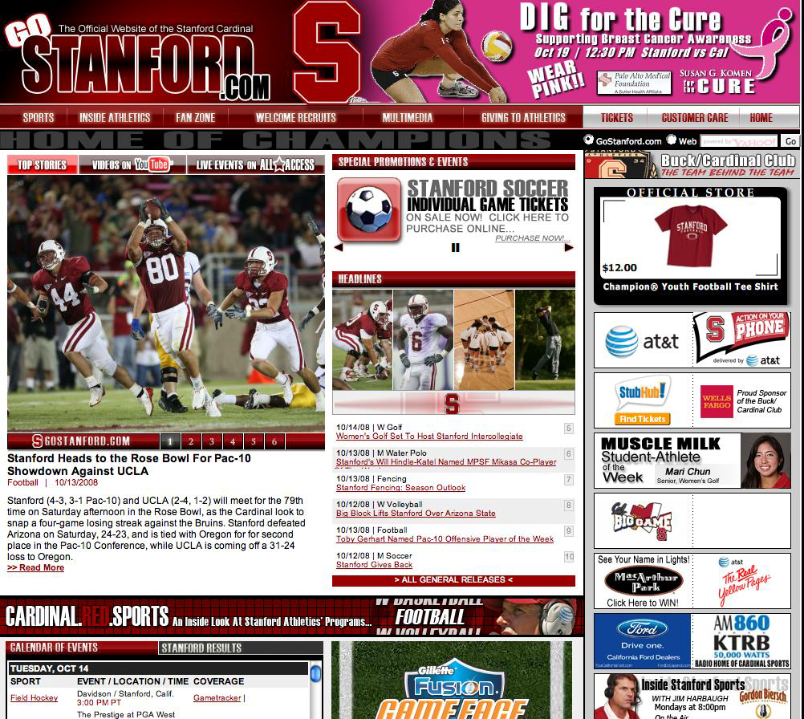
The Making of a Good Design
Content is important, but content alone will not make your
site work.
6

Slide 7
Graphic Design and Page Template Creation
Think about the actual HTML, PDF, graphic, sound, and other files you will
need in the site;
•Where will they be placed?
•How will visitors access them?
Designers prepare sketches and page mockups to represent page layouts
All page layouts start with a mockup; Mockups can be easily edited based
on feedback
Wireframes document a more stable page design
Wireframes offer a more complete view of what the final design will look
like

Slide 8
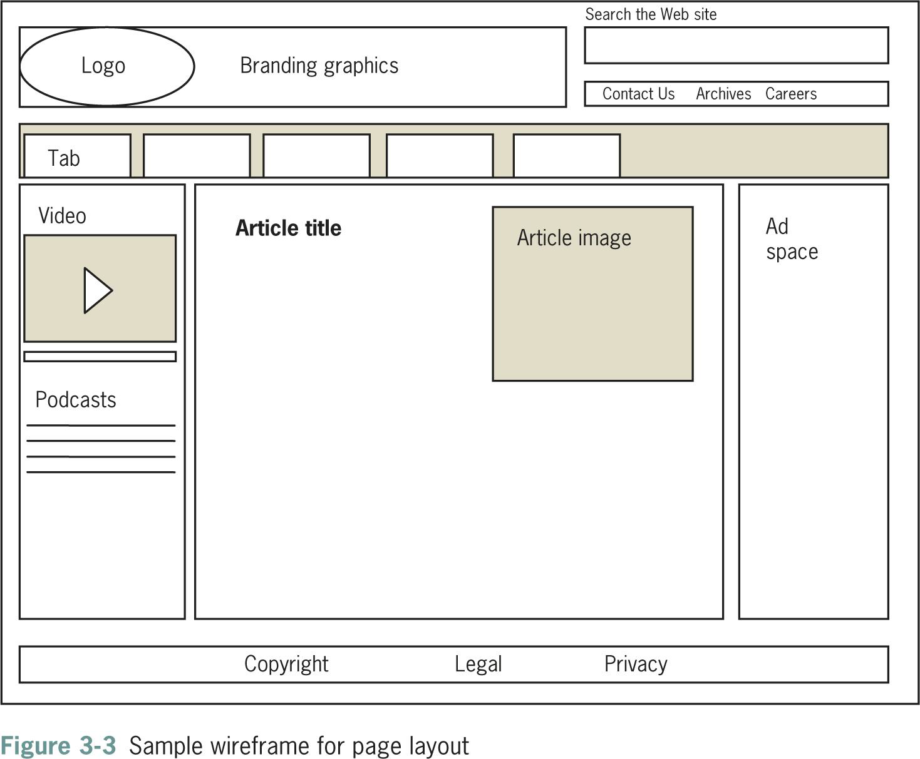

Slide 9
Influences of Technology on Design
•Browsers
Till 2010, Internet Explorer was the dominant browser and
now______________
<http://www.w3schools.com/browsers/browsers_stats.asp>
•User screen sizes
95% of users are using a display with 1024x768 pixels or more
and a color depth Newer computers use 24 or 32 bits display
hardware, and are able to display 16,777,216 different
colours.
<http://www.w3schools.com/browsers/browsers_stats.asp>
9

Slide 10
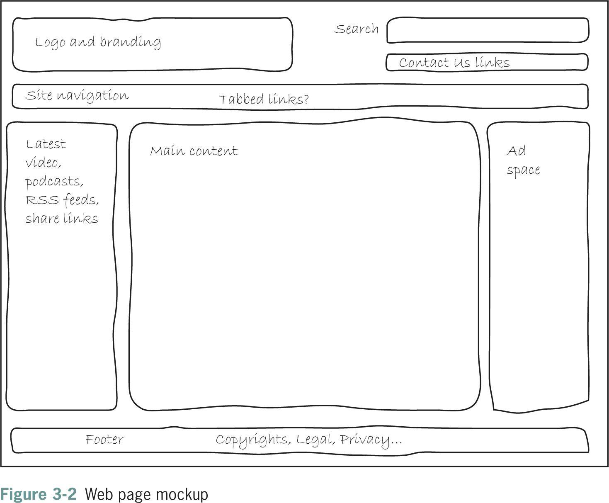
Anatomy of a website
•Container
•Logo
•Navigation
•Content
•Footer
•Whitespace

Slide 11
Layout and Composition
▪Design information to be easy to read and legible
▪Break text into reasonable segments
▪Provide contrasting colors that are easy on the eye
▪Use plenty of white space
Balance
▪Readers have different online reading habits
▪Include plenty of headings
▪Control the width of your text

Slide 12
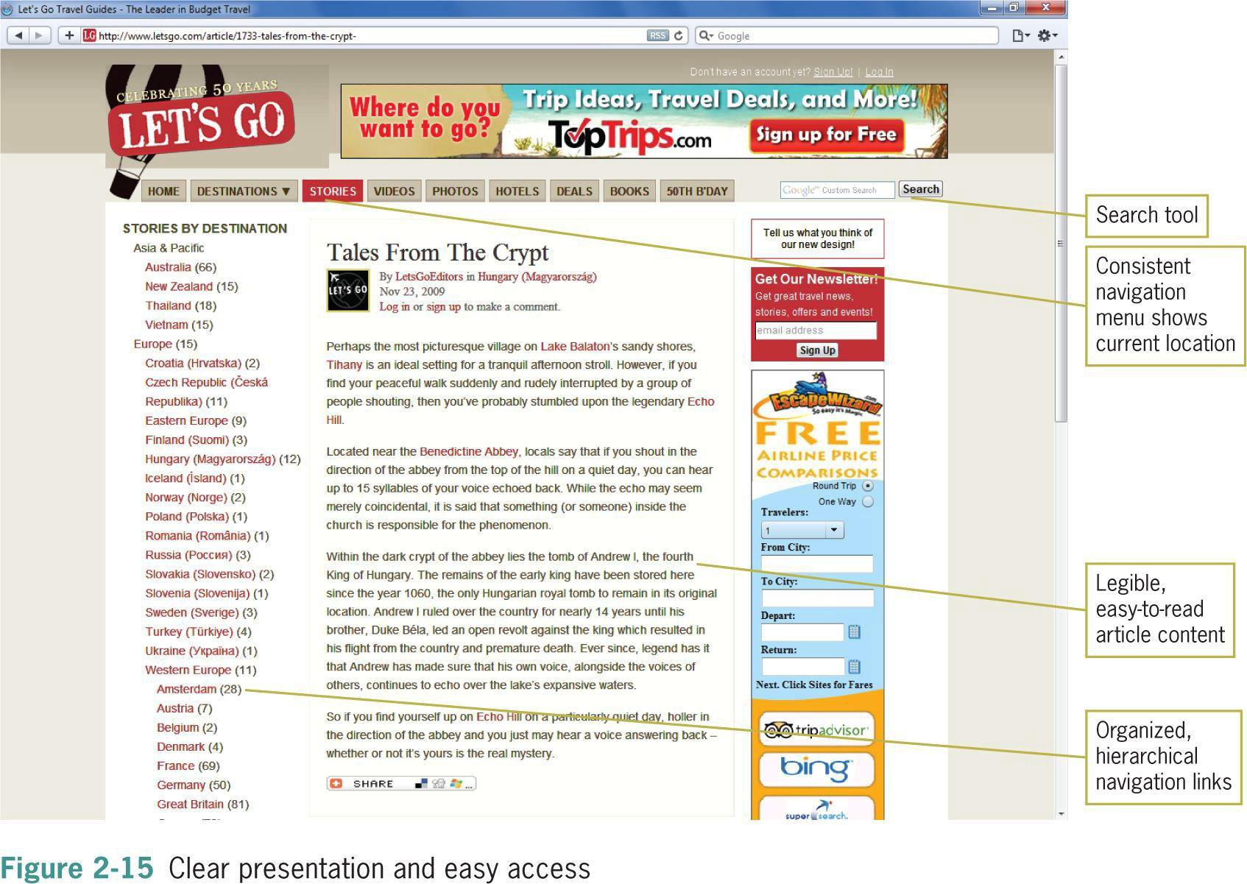

Slide 13
Creating a Unified Site
Design
▪Plan the unifying themes and structure for your site
▪Communicate a visual theme with your design choices
Consider more than each page
a) Plan smooth transitions
b) Use a grid to provide visual structure
Unity
c) Include active white space

Slide 14
Plan Smooth Transitions
▪Plan to create a unified look
▪Reinforce identifying elements
▪Consistency and repetition create
smooth transitions
▪Place navigation elements in the
same position on each page
▪Use the same navigation graphics
throughout the site

Slide 15
Use a Grid to Provide Visual
Structure
▪The structure of a Web page is imposed by the grid
▪The grid is a conceptual layout device
▪The grid aligns your content into columns and rows
▪Impose a grid to provide visual consistency
Grid Theory
▪You can break out of the grid to provide variety and
highlight information
▪The grid provides page margins and gutters
between elements

Slide 16
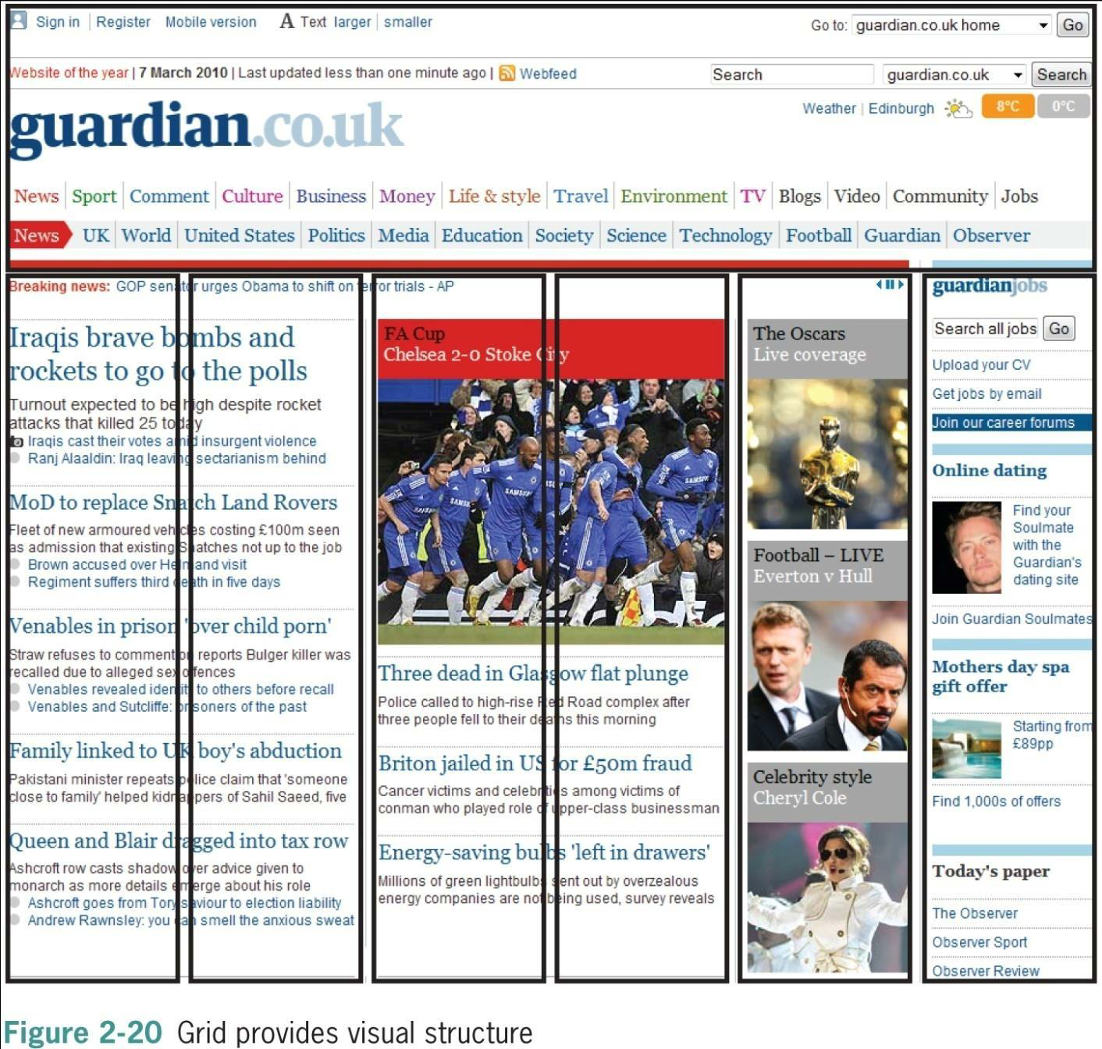

Slide 17
Use Active White
Space
▪White spaces are the blank areas of the page
▪Use white space deliberately
▪Good use of white space guides the reader
White space that is used deliberately is called active white space
▪Passive white space is the result of mismatched shapes
▪Plenty of active white space reduces clutter and clarifies
organization

Slide 18
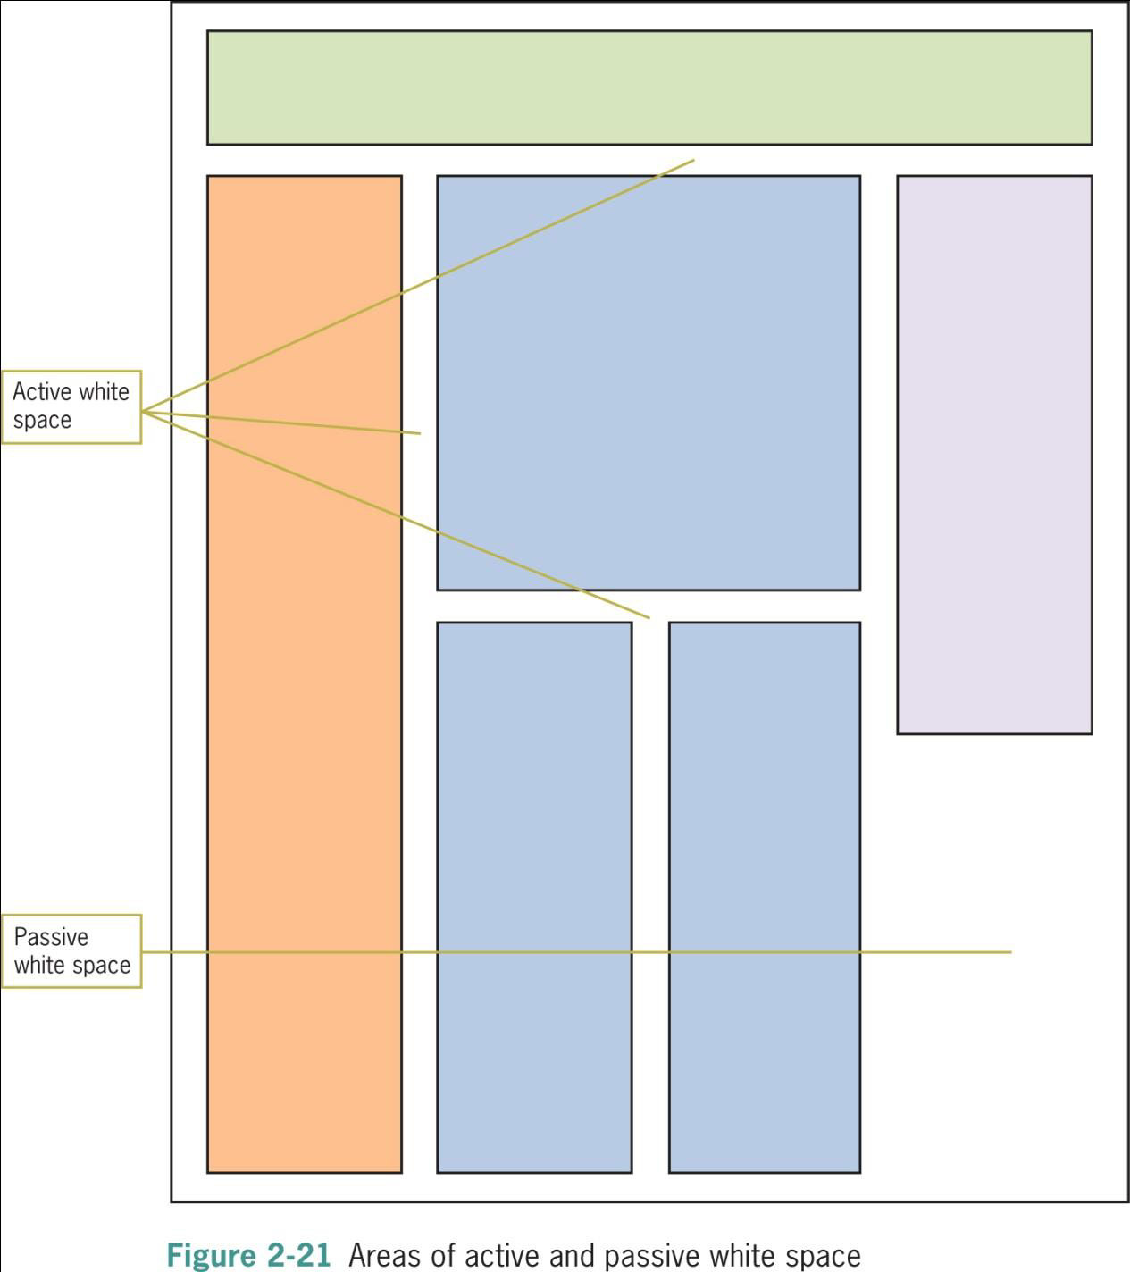

Slide 19
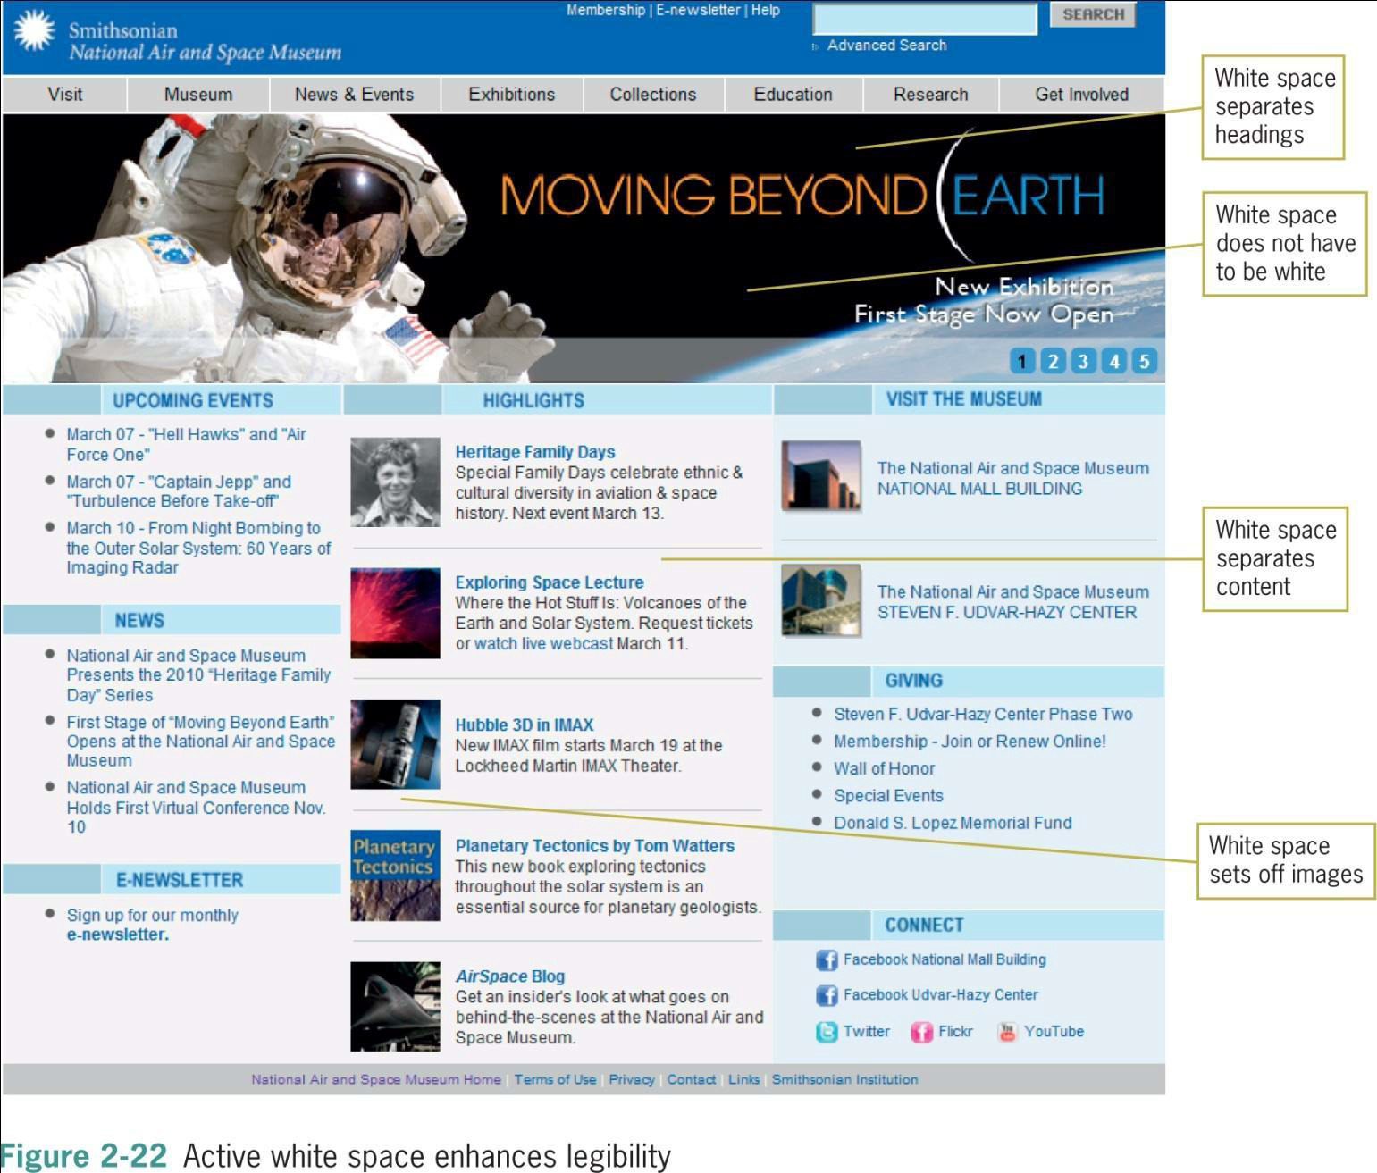
Principles of Web Design 5th Ed. 42

Slide 20
Designing for the
User
▪Keep your design efforts centered solely on your user
▪Find out what users expect from your site
▪If you can, survey them with an online form
▪Create a profile of your average user
▪What do users want when they get to your site?

Slide 21
Design for
Interaction
▪Think about how the user wants to interact with your information
▪Design for your content type
▪Decide whether the user is likely to read or scan
▪Design pages for reading or scanning based on the content type

Slide 22
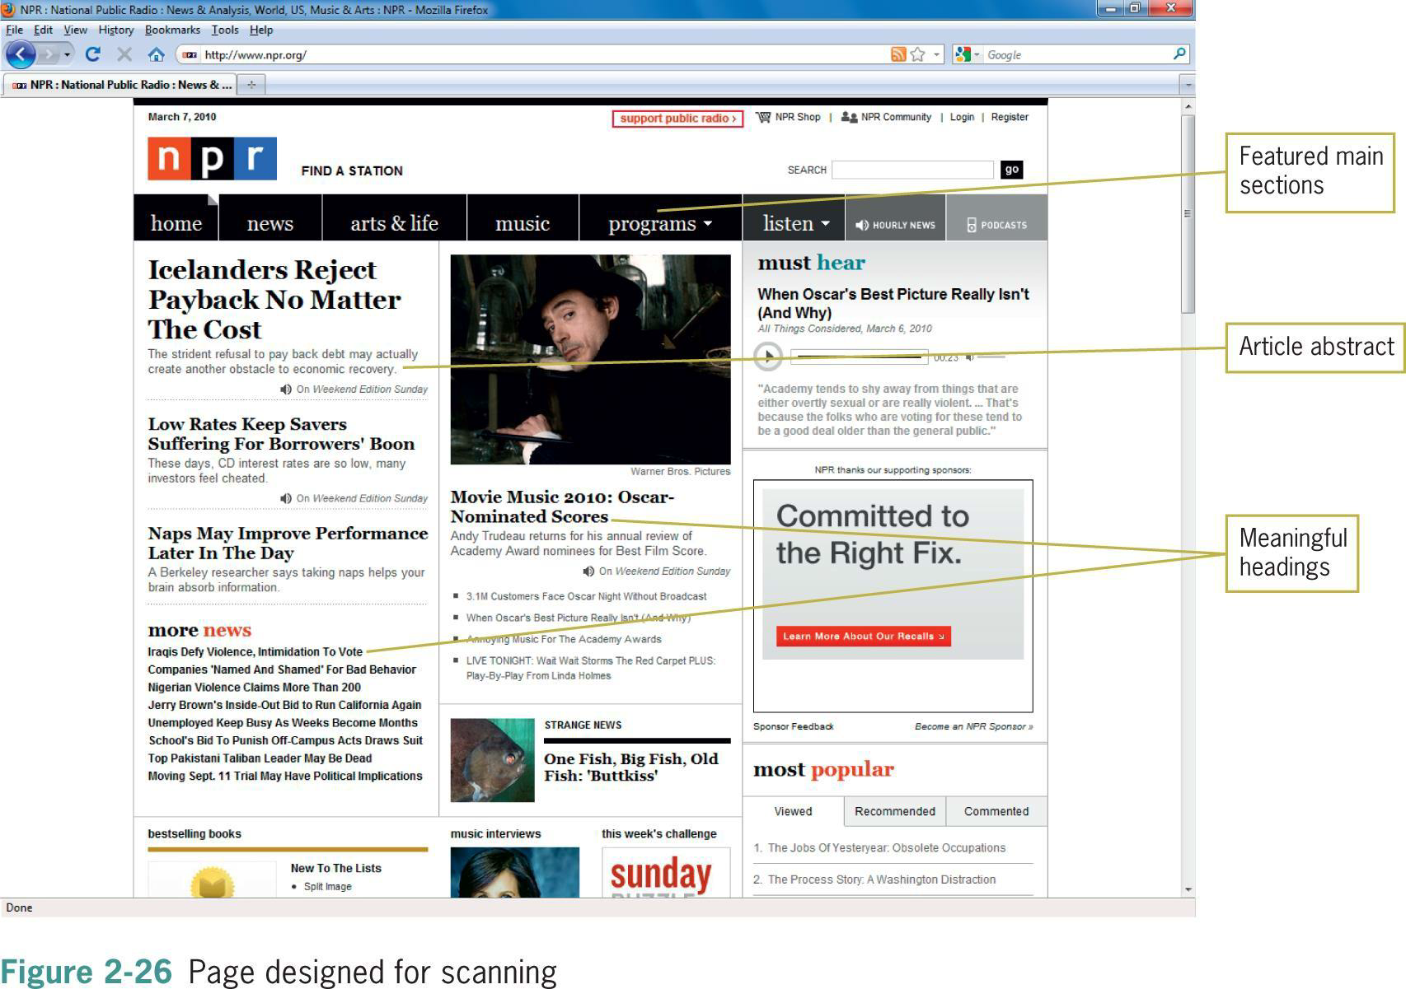

Slide 23
Design for
Location
▪The user can traverse a page in a variety of ways
▪Consider the different ways your user could be viewing your
Web pages

Slide 24
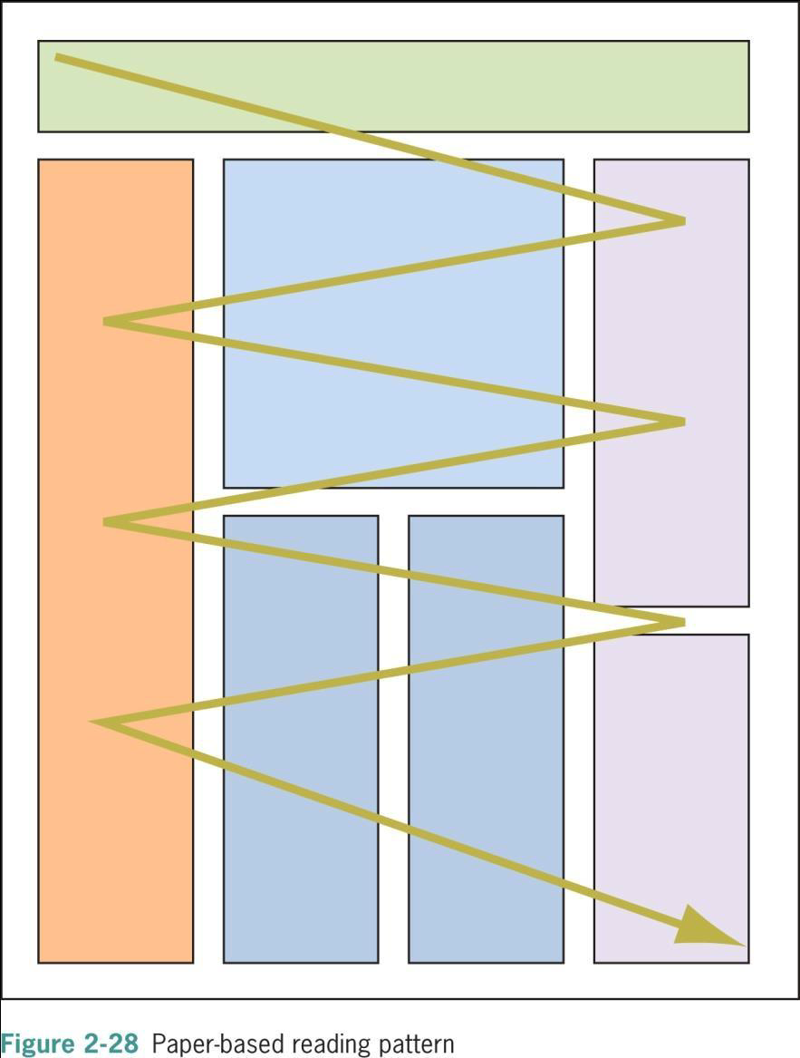
Principles of Web Design 5th Ed. 48

Slide 25
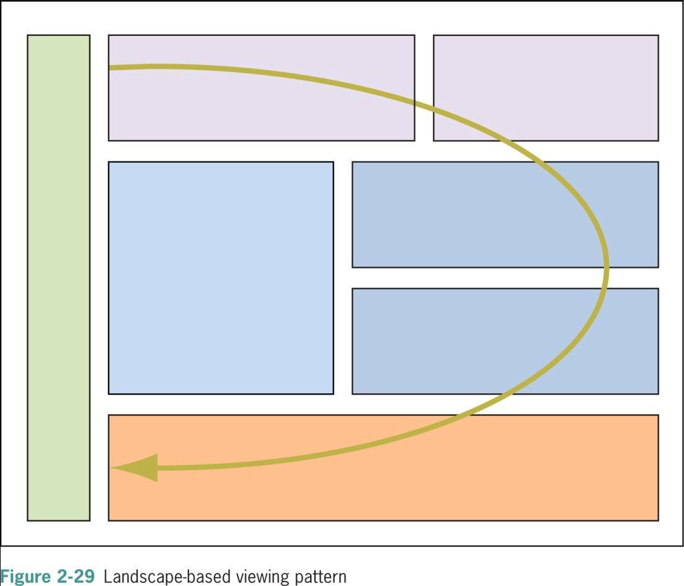

Slide 26
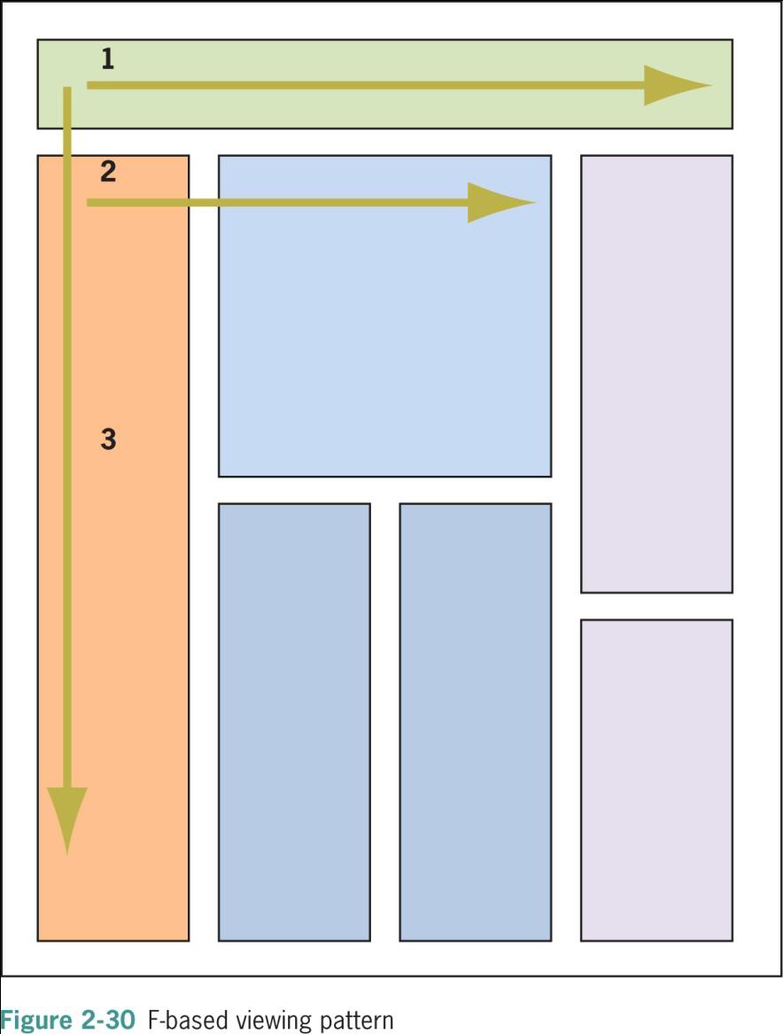

Slide 27
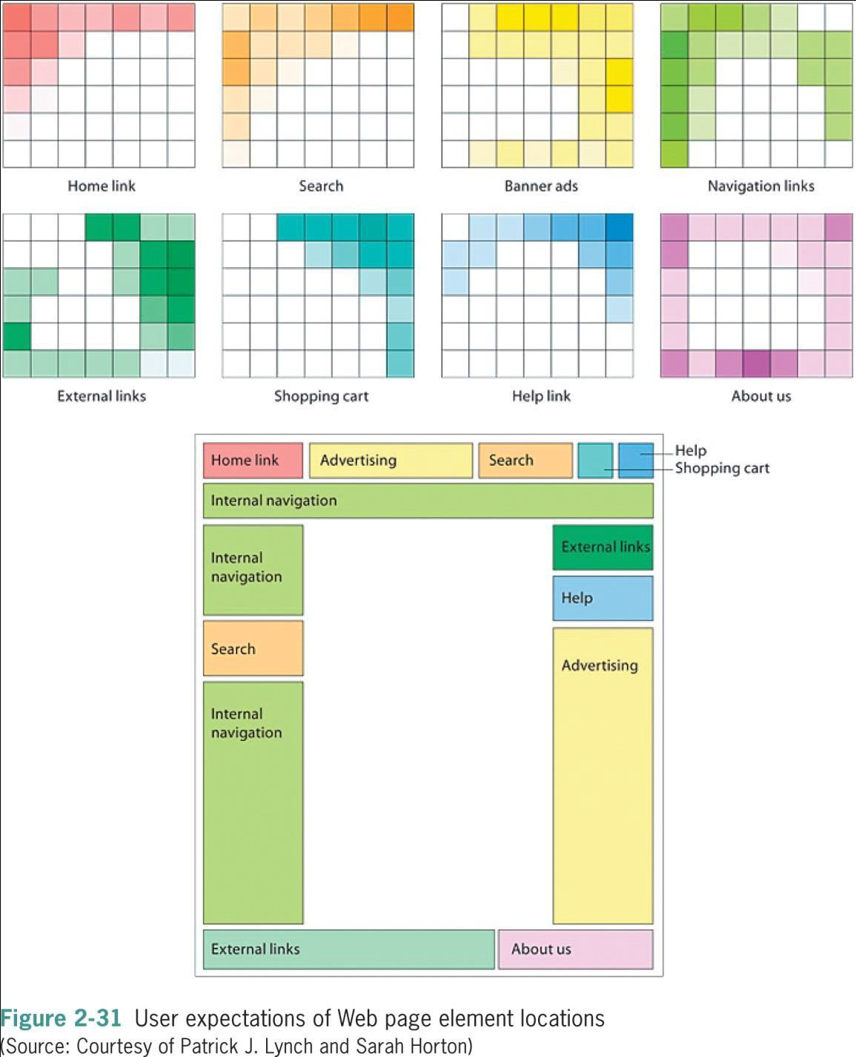
Principles of Web Design 5th Ed. 52

Slide 28
Design for the
Screen
▪The computer display is very different from print-based media; the
display is landscape-oriented for desktop, portrait and landscape for mobile
apps etc.
▪Know what expectations your user might have about your
navigation and content
▪Users have come to expect common elements of a Web page in
certain locations

Slide 29
Keep a Flat
Hierarchy
▪Do not make users navigate through too many layers of
information
▪Includes section on topic-level navigation pages
▪Create content sections organized logically by theme
▪Follow the three clicks rule; a user of a website should be able to find any information
with no more than three mouse clicks.
▪Use consistent navigation
▪Consider providing a site map

Slide 30
Use Hypertext Linking
Effectively
▪You determine where users can go on your Web site
▪Let users move from page to page or section to section as they
please
▪Use contextual linking
▪Avoid the use of “click here”
▪Provide plenty of navigation options

Slide 31
How Much Content Is Too
Much?
▪Don’t overcrowd your pages with information
▪Be conscious of the cognitive load of the user
▪Carefully divide content into smaller sections
▪Present content in a structured manner
▪Provide plenty of navigation cues.

Slide 32
Reformat Content for Online Presentation
▪Cannot post print documents directly online
▪Text length, font, and content length do not transfer well
▪Re-design paper content for online display

Slide 33
Designing for
Accessibility
▪Your audience includes users who have physical challenges;
▪Design your pages to be accessible to users with disabilities or
technological barriers
▪Common accessibility features can be unobtrusive additions to your
site
▪Developing accessible content naturally leads to creating good design
▪Follow W3 Accessibility Initiative guidelines at www.w3.org/WAI/ .

Slide 34
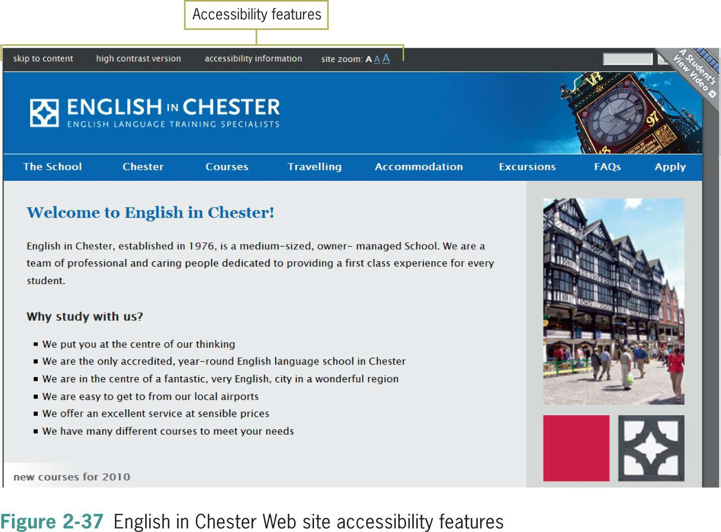

Slide 35

Summary
▪Craft an appropriate look and feel;
▪Make a design portable;
▪Plan for easy access to your information;
▪Design a unified look for your site;
▪Use active white space;
▪Know your audience;
▪Leverage hypertext linking;
▪Design text for online display;
▪Test your work continually as you build;
▪Build accessibility from the start.

Slide 36
Understanding the Web Site Development
▪You need a good project plan;
▪Larger projects need a project manager;
▪Adopt a development framework; and
▪The project life cycle encompasses the entire project from start to finish.
Joel Sklar (2012), Principles of Web Design, 5th Edition, Cengage, Chapter 2

Slide 37
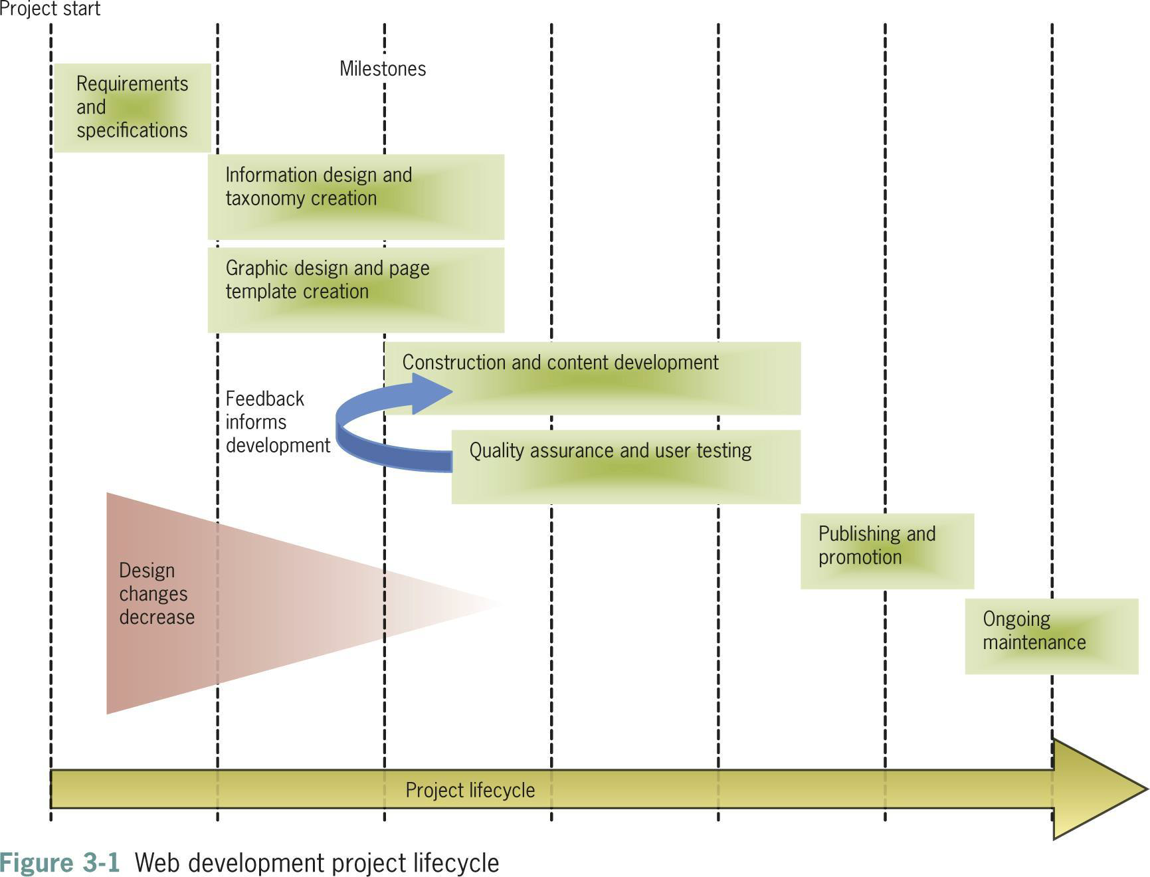
Joel Sklar (2012), Principles of Web Design, 5th Edition, Cengage, Chapter 2

Slide 38
Requirements and Specification
▪The client presents the requirements for the site
▪Requirements are the list of customer needs
▪The project team breaks the requirements down to tasks
▪The team prepares a project specification that contains:
▪Page layout sketches
▪Audience definition
▪Technical requirements
Joel Sklar (2012), Principles of Web Design, 5th Edition, Cengage, Chapter 2

Slide 39
Information Design and Taxonomy Creation
▪User analysis guides the design of site content
▪Goal is to create meaningful content navigation
▪Taxonomy is a classification and naming of contents in a hierarchy
▪The taxonomy of the site structures, the topic hierarchy and
navigation

Slide 40
Creating a Site Specification
▪Who is the client for the site?
▪Can you write a two- or three-paragraph mission statement that
briefly states the site’s goals?
▪What do you envision as the goal of the site?
▪What do you (or your company or organization) hope to gain from
creating and maintaining a Web site?
▪What are the requirements for the Web site?

Slide 41
Creating a Site Specification
▪Are the requirements feasible?
▪How will you judge the success of the site?
▪Who is the target audience?
▪What are the limiting technical factors?
▪What is the budget?
▪Is this a new site or an upgrade?

Slide 42
Identifying the Content Goal
▪Examine closely what type of site you are building
▪Your objectives and your users’ objectives may be quite different
▪Adopt your users’ perspective
▪Think about the type of content you’re presenting and look to the
Web for examples of how best to present it

Slide 43
Identifying the Content Goal
▪Types of Web sites:
▪Billboard
▪Publishing
▪Portal
▪Special interest
▪Blog
▪Social networking

Slide 44
Identifying the Content Goal
▪Wikis
▪RSS
▪Virtual gallery
▪E-commerce, catalog, online shopping
▪Product support
▪Intranet/Extranet

Slide 45
Analyzing Your Audience
Produce an audience definition:
▪What is it that users want when they come to your site?
▪How can you attract them and entice them to return for repeat
visits?
▪What type of computer and connection speed do your typical
visitors have?

Slide 46
Analyzing Your Audience
▪Who are the typical members of your audience?
•Are they male or female?
▪What level of education do they have?
•What is their reading and vocabulary level?
•What level of technical aptitude do they have?
▪Why do people come to your site?
•Do they want information?
•Do they want to download files?
•Are they looking for links to other Web sites?

Slide 47
Using Web Analytics
▪Web analytics are statistics gathered by Web servers
▪Reporting tools can analyze the statistics
▪You can track user activity on your Web site
▪You can see where your visitors come from and which pages they like
the best

Slide 48
Identifying Technology Issues and
Accessibility Constraints
▪Think about where users are located and what their technology
level might be
▪Test in different environments and with different technologies
▪Consider the physical capabilities of your users

Slide 49
Identifying Technology Issues and
Accessibility Constraints
▪You can identify accessibility constraints
▪Review the WCAG 2.0 and section 508 guidelines
▪In new sites, plan for accessibility
▪In existing sites, assess the current accessibility
▪Look to other real-life accessibility implementations

Slide 50
Creating a Site Storyboard
❑ Plan your site by creating a storyboard flowchart
❑ The flowchart shows structure logic and taxonomy
❑ This is an important planning step
❑ You can visualize and refine your site design

Slide 51
Organizing Information Structure
❑ Think about your users’ information needs
❑ How should your information design map look?
❑ Review the following sample structures and adapt them to
information needs

Slide 52
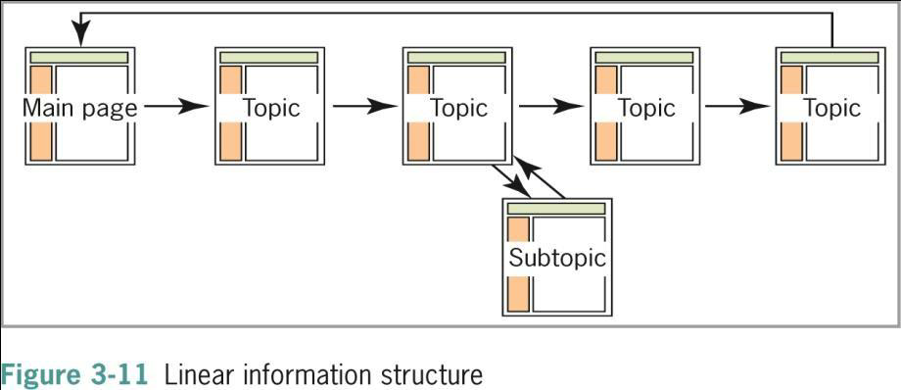
Linear Structure

Slide 53
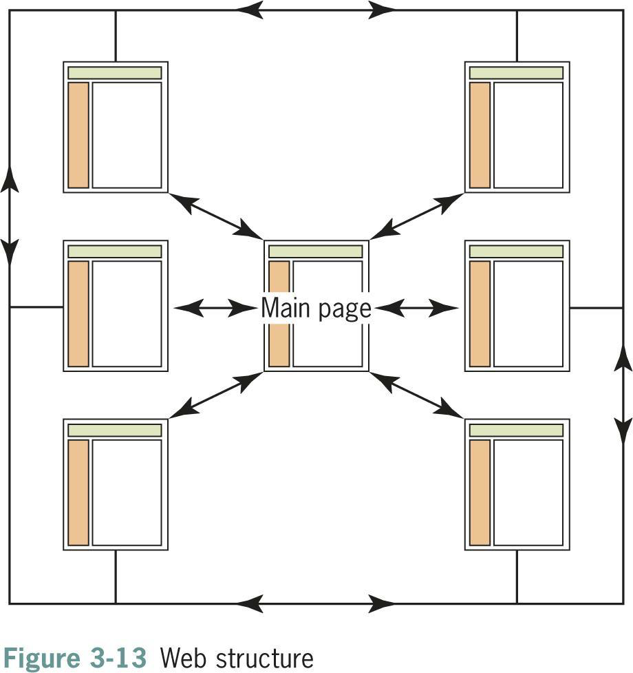
Web Site Structure

Slide 54
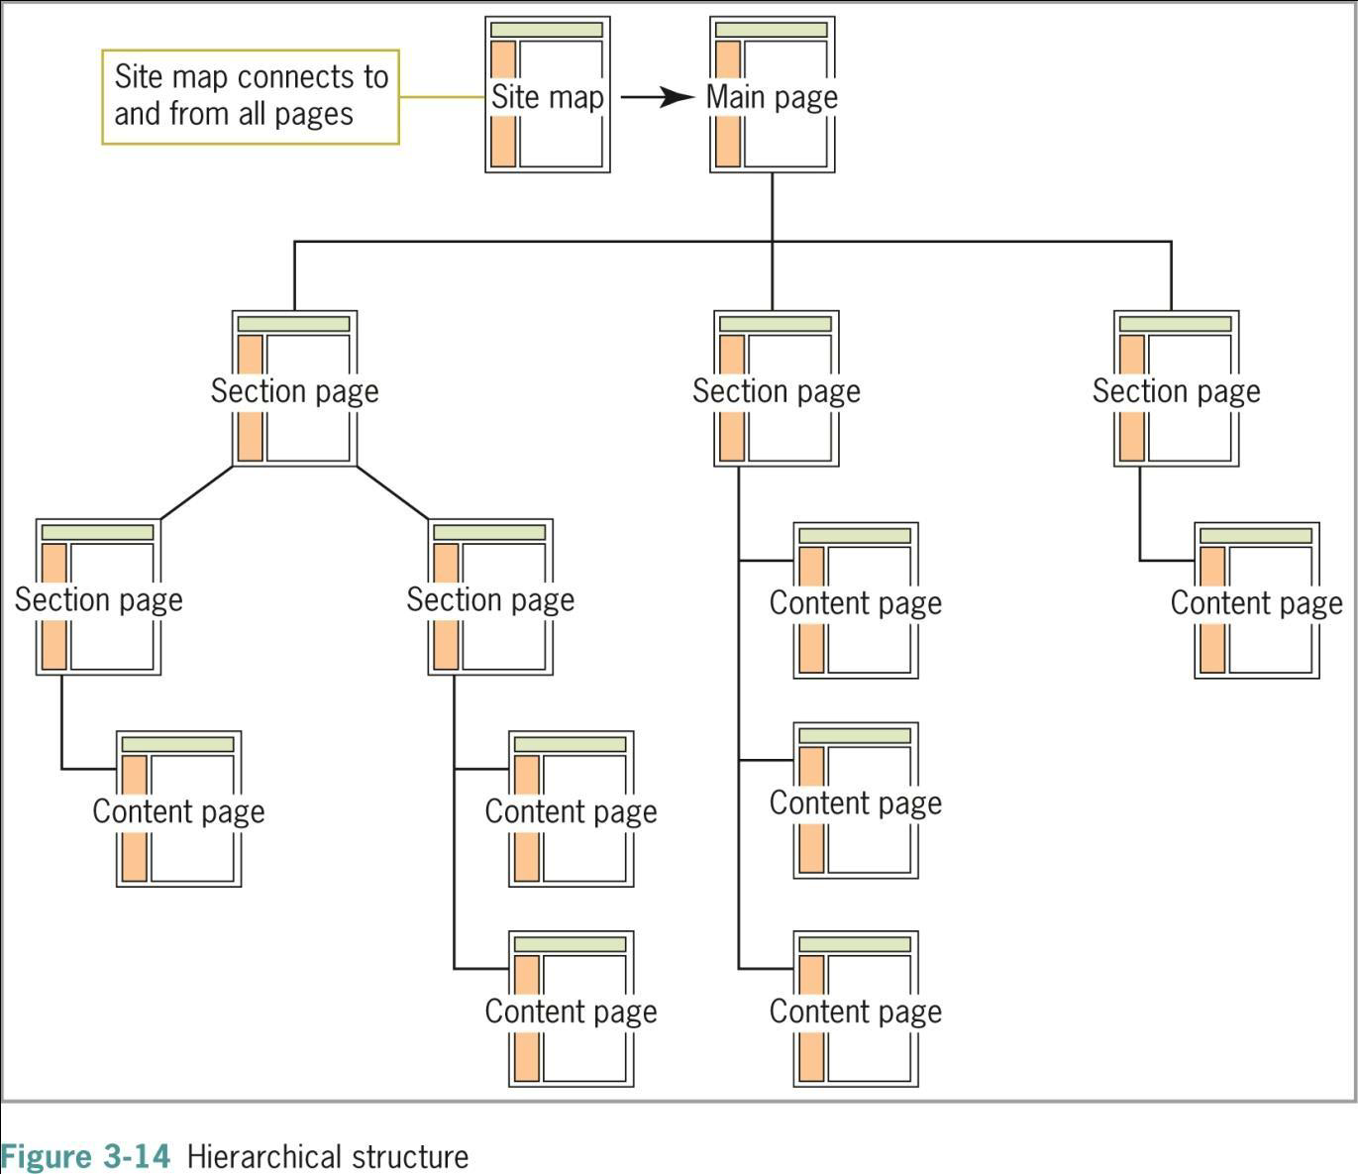
Hierarchical Structure

Slide 55
Summary - I
A successful Web site is the result of careful planning
Become familiar with the Web development lifecycle
Start with pencil and paper
Write a site specification document
Identify the content goal
Analyze your audience
An effective site is a team effort

Slide 56





56

Slide 57
What is version control?
•What is version control?
1. It is a system that keeps record of your code changes.
2. Allows you to undo or revert to any of your previous
code state.
3. Allows for team environment and collaborative
development.
4. Keeps track of who made the changes and when.
57

Slide 58
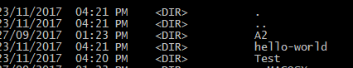
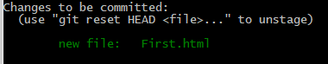
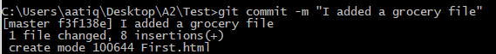
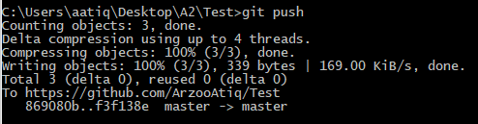
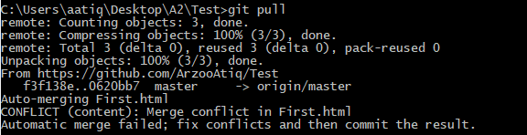
Quick Guide to GitHub
•Make an account
•Create repository in GitHub
•On your machine make a folder or use an existing
folder.
•From your machine command line:
–Use command: git clone <path of repository you created
on GitHub>
–Create file in the folder you created
–Use git add <filename>
–Then see the status using git status
–If you see that your file is there, in red
–Use git commit –m “any message”
–Then use git status again to see that your file should be
visible in green.
–To send it to your online GitHub, use git push and file
name
–To download a file from the github, use git pull
command.

Slide 59
Useful HTML Elements
•<section>
•<div>
•<span>

Slide 60
<div>
•It is used for giving structure to HTML pages.
•Divides the web page into different divisions.
•Why? It is helpful in formatting and layout designs separation.
•Syntax:
–<div style="color:#0000FF">
<h3>This is a heading</h3>
<p>This is a paragraph.</p>
</div>
–In HTML5 there is a <header> element, as well as a <nav>, <footer> and a
couple other new elements that replace these div tags.

Slide 61
Quick Guide
•The new section element defines a part of a website with related content. It
should not be used as a generic container element or for pure styling purposes.
In that case rather use a simple div.
•An article defines an independent piece of content which should be able to
stand alone and still make sense.
•A header defines a header for a document or a section.
•A footer is used for defining the footer of a document or a section.
•A nav defines a set of navigation links which should be the main navigation of
your website.
•An aside defines a section with secondary content. If an aside is placed within
an article the content should be related to that specific article. If it is placed
outside an article the content should be related to the site as whole.

Slide 62
<section> Element
•The <section> element and the elements we have covered in the last five pages
are examples of what are known as semantic HTML.
•Semantic HTML is the use of HTML markup to reinforce the semantics, or
meaning, of the information in webpages rather than merely to define its
presentation. (wiki)
When to use?
•If all you want to do is have something look different use a div tag (a
generic container) and CSS styles.
•If you want a particular part of a page separated from the rest of the page due
to the information in it - its "content", use section elements (a generic section).
Use the section element if there is what W3C calls a "semantic" distinction.
•All these new tags: header, nav, article, footer, aside and section are as a group
called section elements

Slide 63
<span> element
•The HTML <span> element is a generic inline container for phrasing
content, which does not inherently represent anything.
•It can be used to group elements for styling purposes (using the
class or id attributes), or because they share attribute values, such
as lang.
•It should be used only when no other semantic element is
appropriate. <span> is very much like a <div> element, but <div> is
a block-level element whereas a <span> is an inline element.

Slide 64
Block-level elements vs Inline elements
•A block-level element always starts on a new line and takes up
the full width available (stretches out to the left and right as far
as it can).
•An inline element does not start on a new line and only takes
up as much width as necessary.
•https://www.w3schools.com/html/html_blocks.asp

